Slide 1
Consumer’s Equilibrium

Slide 2
Consumer’s Equilibrium
A situation where a consumer spends his given income purchasing one or more commodities so that he gets maximum satisfaction and has no urge to change this level of consumption, given the prices of commodities, is known as the consumer’s equilibrium.

Slide 3
Condition of consumer equilibrium in case of a single commodity
The consumer will be in the state of equilibrium when the following condition is fulfilled:
The marginal utility of commodity X in terms of rupees is equal to the price of commodity X in rupees.
[MUx (in ₹) = Px (in ₹)]
Or
Mux (in utils) = Px (in ₹) or MU of Commodity X (in utils) = Px (in₹)

Slide 4
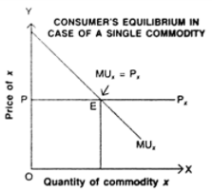

Slide 5
Consumer Equilibrium in Case of Two Commodity
For a consumer to be in the state of equilibrium, the following conditions must be fulfilled:
MUx/Px = MUy/Py
Where,
MUx= Marginal Utility of commodity X;
Px= Price of commodity X
MUy= Marginal Utility of commodity Y;
Py= Price of commodity Y

Slide 6
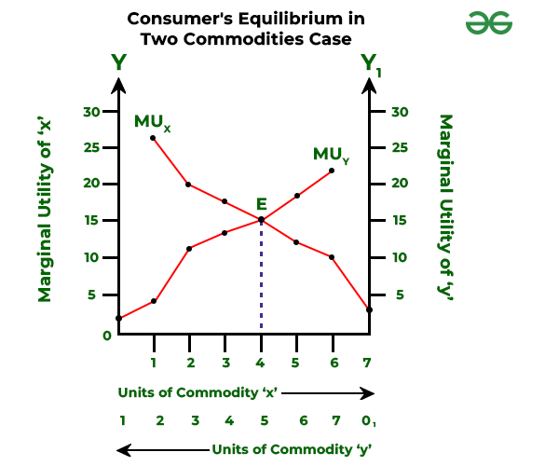

Slide 7
THANK YOU

